Slide 1
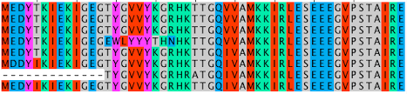
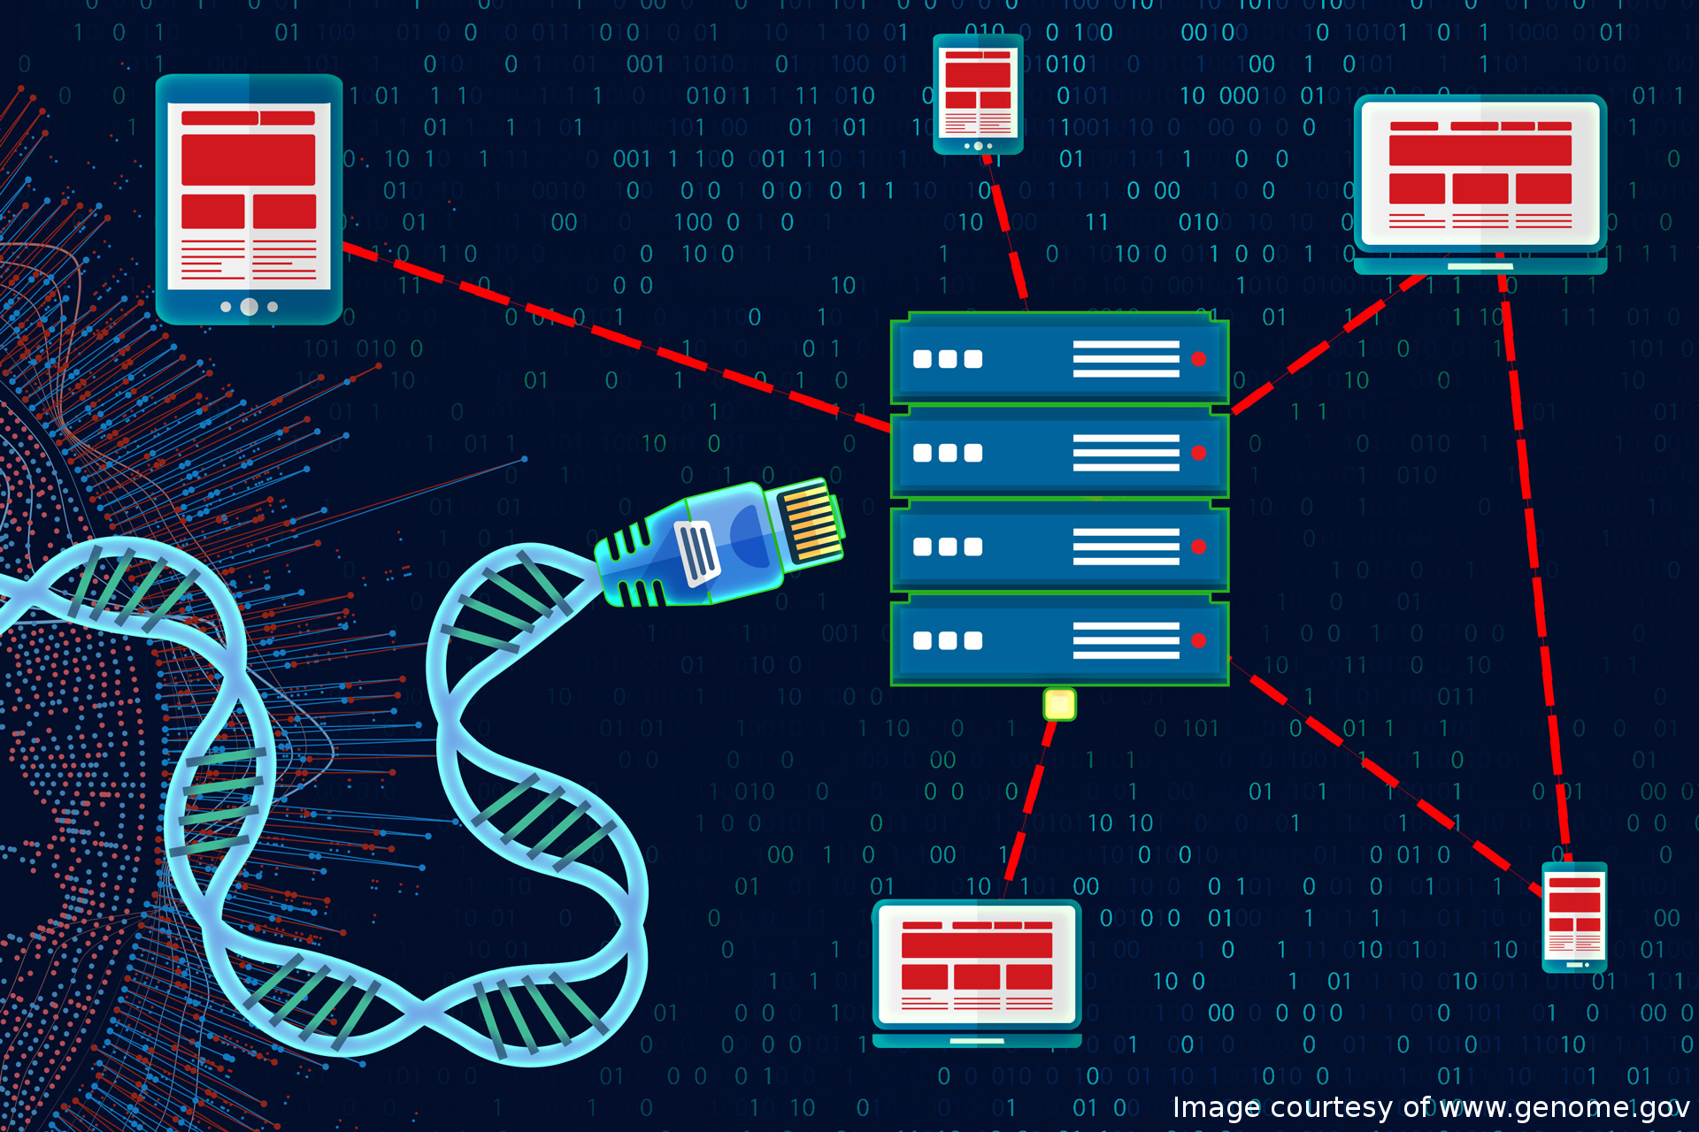
B204: Genomics
“Introduction to Bioinformatics”
Dr. Arun Prasanna
Prof. Manuel Aranda

Slide 2
Introduction to Bioinformatics
What is Bioinformatics?
Why Bioinformatics?
Application examples (Hands-On)

Slide 3
1. WHAT IS BIOINFORMATICS?

Slide 4
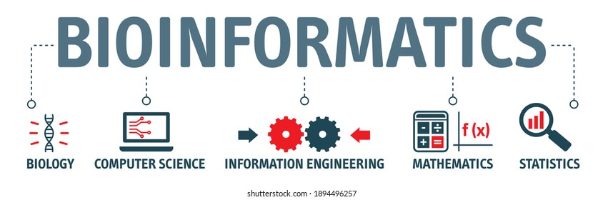
Bioinformatics is an interdisciplinary field that develops methods and software tools for understanding biological data.
As an interdisciplinary field of science, bioinformatics combines biology, computer science, information engineering, mathematics and statistics to analyze and interpret biological data

Slide 5
2. WHY BIOINFORMATICS?

Slide 6
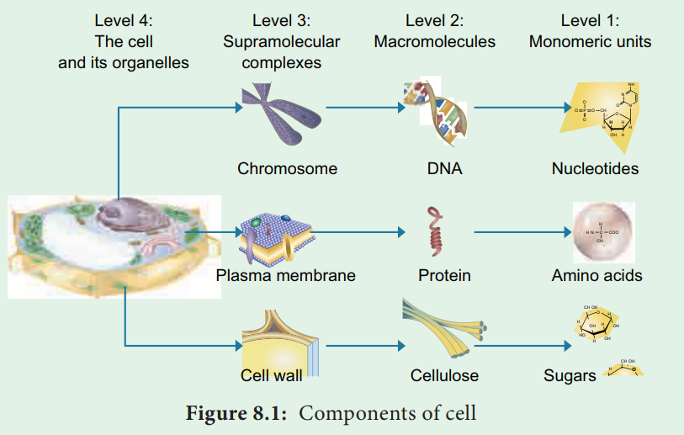
Sequence nature of Biology
“Biology easily has 500 years of exciting problems to work on” – Donald Knuth (Father of analysis algorithms)
By developing techniques for analyzing sequence data and related structures, we can attempt to understand molecular basis of life

Slide 7
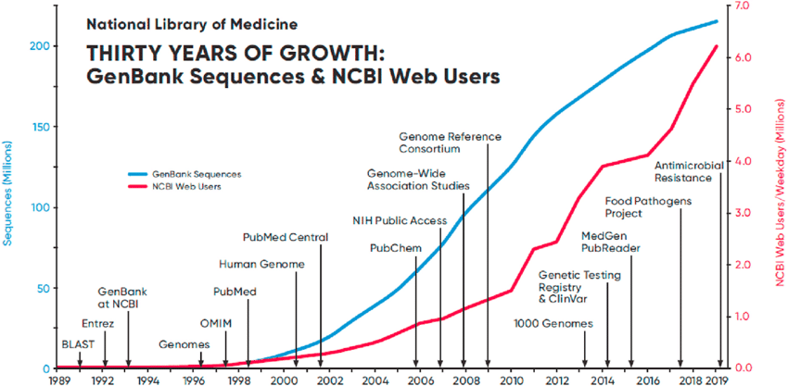
Data Explosion
Our genetic identity is identity the is encoded in long molecules made up of four basic units, the nucleic acids:
Adenine,
Cytosine,
Guanine,
Thymine.
To first approximation, DNA is a language over a four-character alphabet, {A, C, G, T}

Slide 8


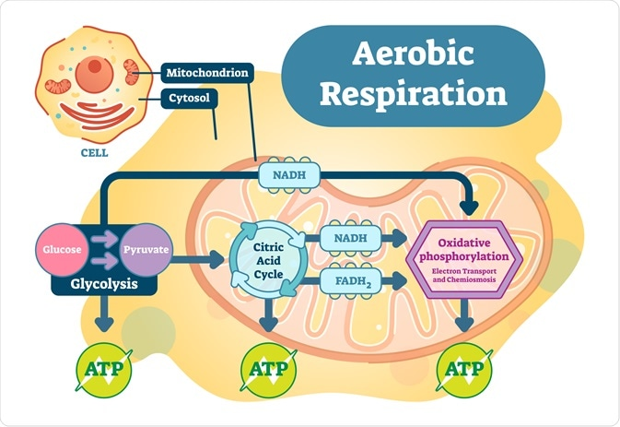
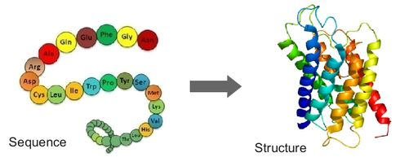
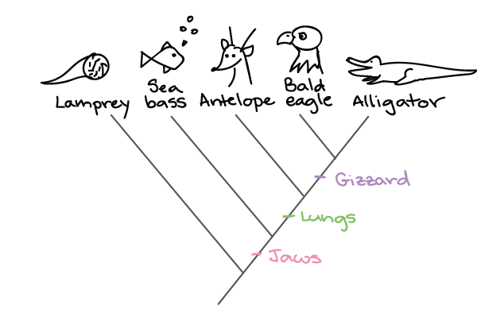
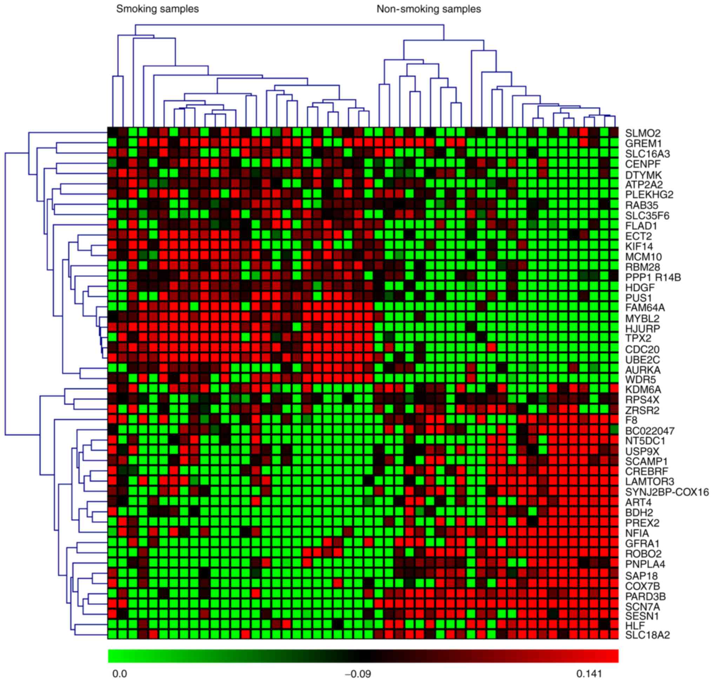
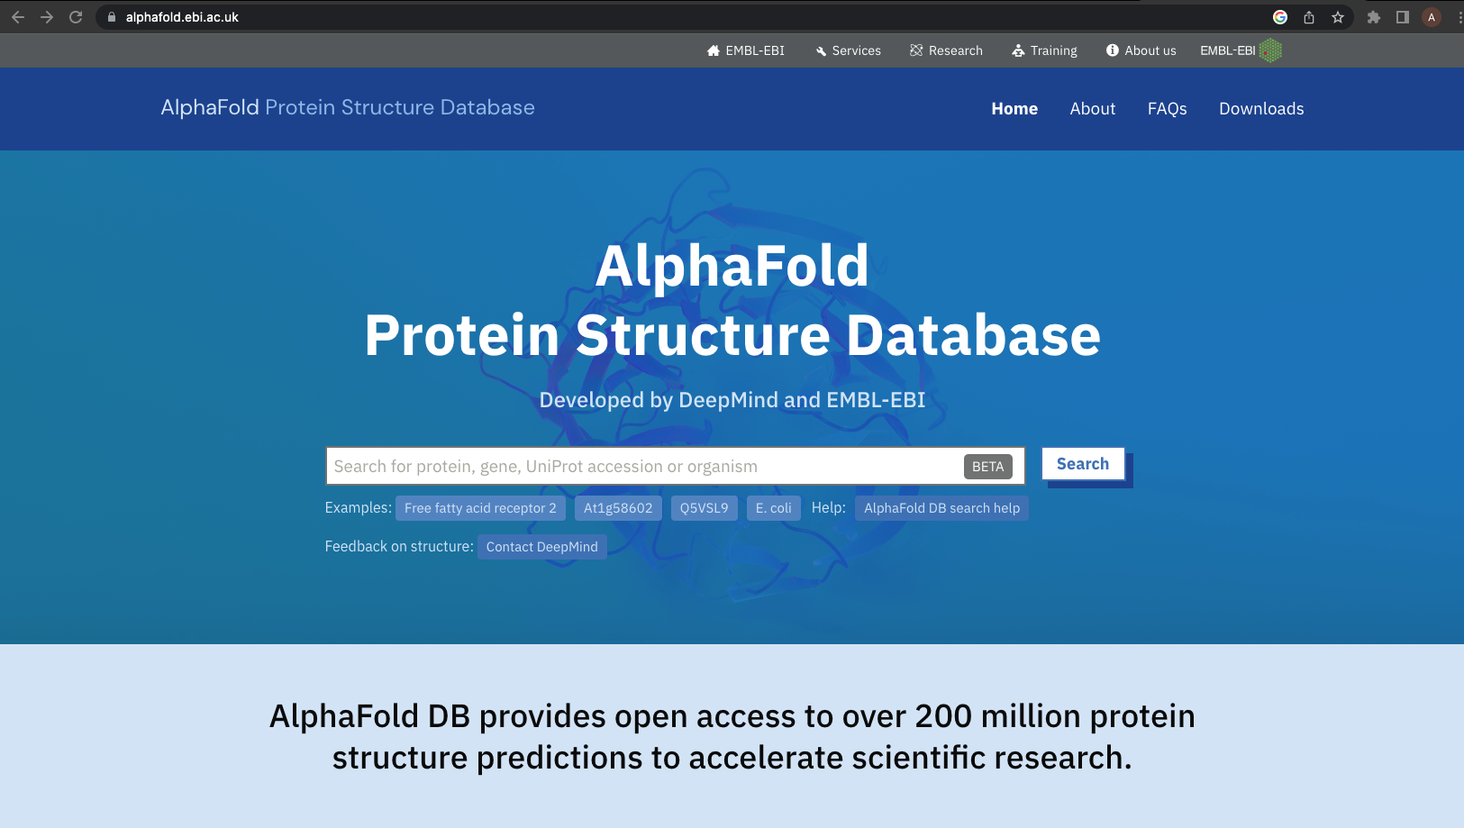
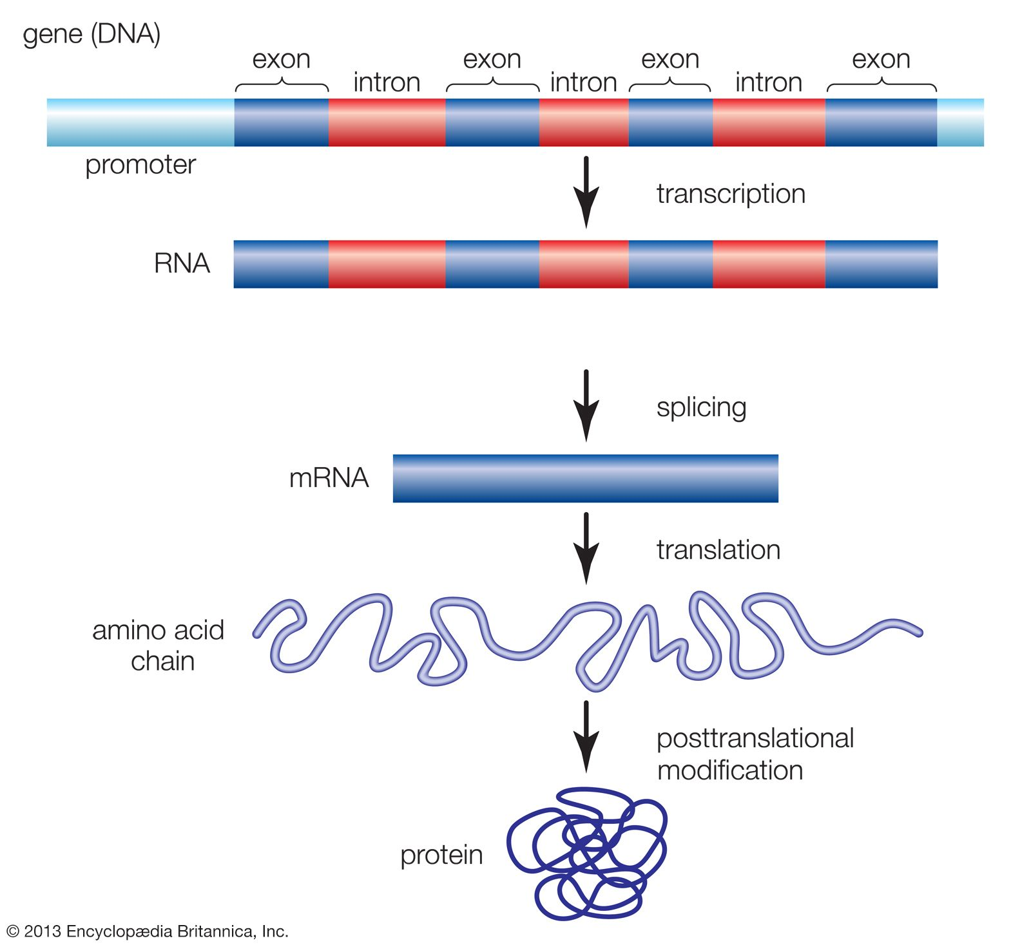
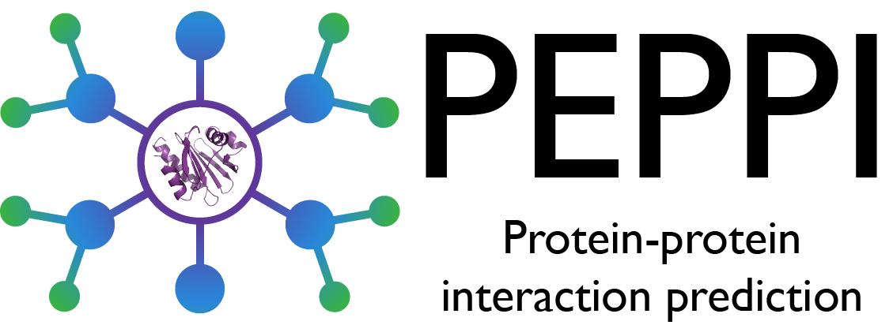
Structure Analysis
Sequence Analysis
Function Analysis
Sequence -> structure -> Function
vs
N.A structure prediction
Protein structure prediction
Protein structure classification
Protein structure comparison

Slide 9
3. APPLICATION EXAMPLES (Hands-On)

Slide 10
Download the folder “BioInfoLecture_B204”
https://github.com/apn83/BioInfoLecture_B204

Slide 11
FASTA file format
A bioinformatics data format
A simple text file
For DNA or protein sequences
For a single or multiple sequence(s)

Slide 12
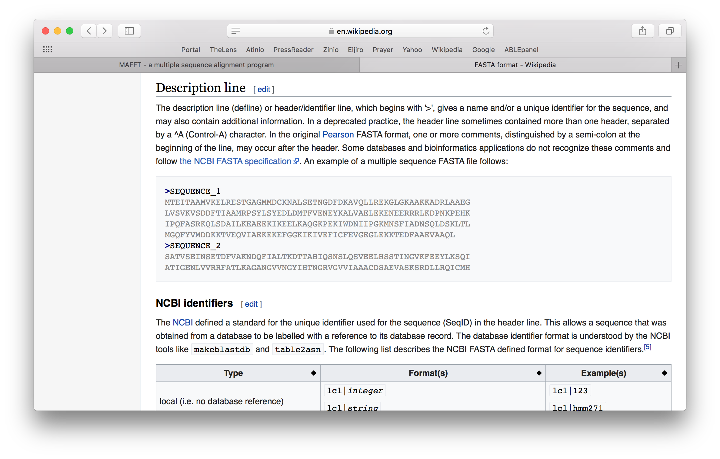
FASTA file format

Slide 13
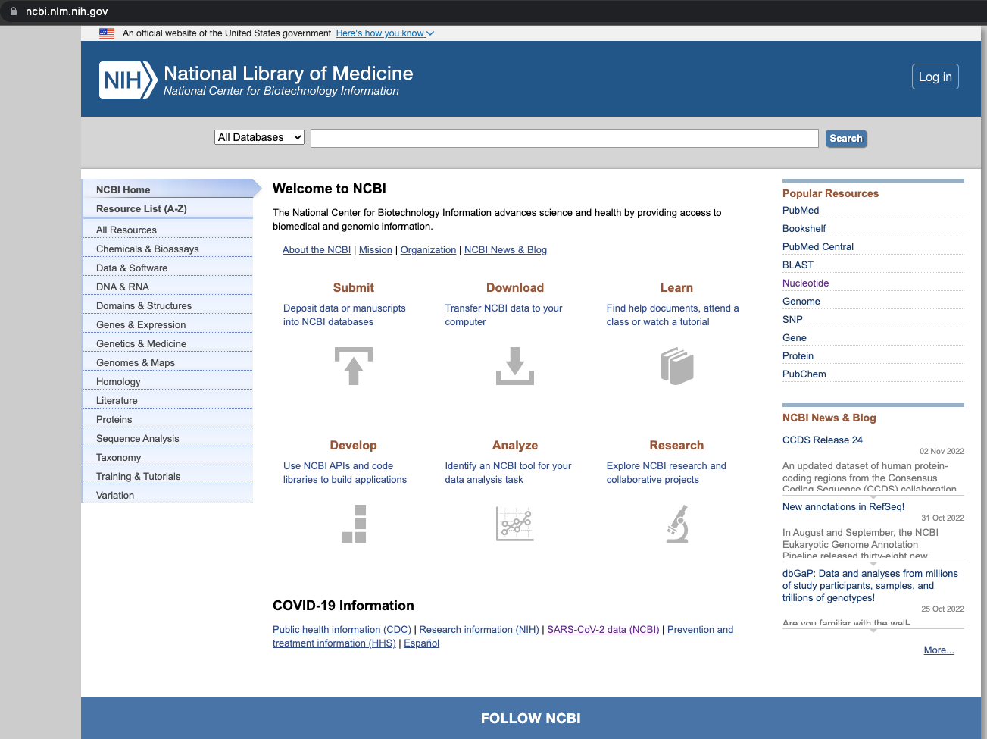
Let’s Open NCBI and Explore !

Slide 14
Let us examine and understand the root cause for Sickle Cell Disease
at sequence level

Slide 15
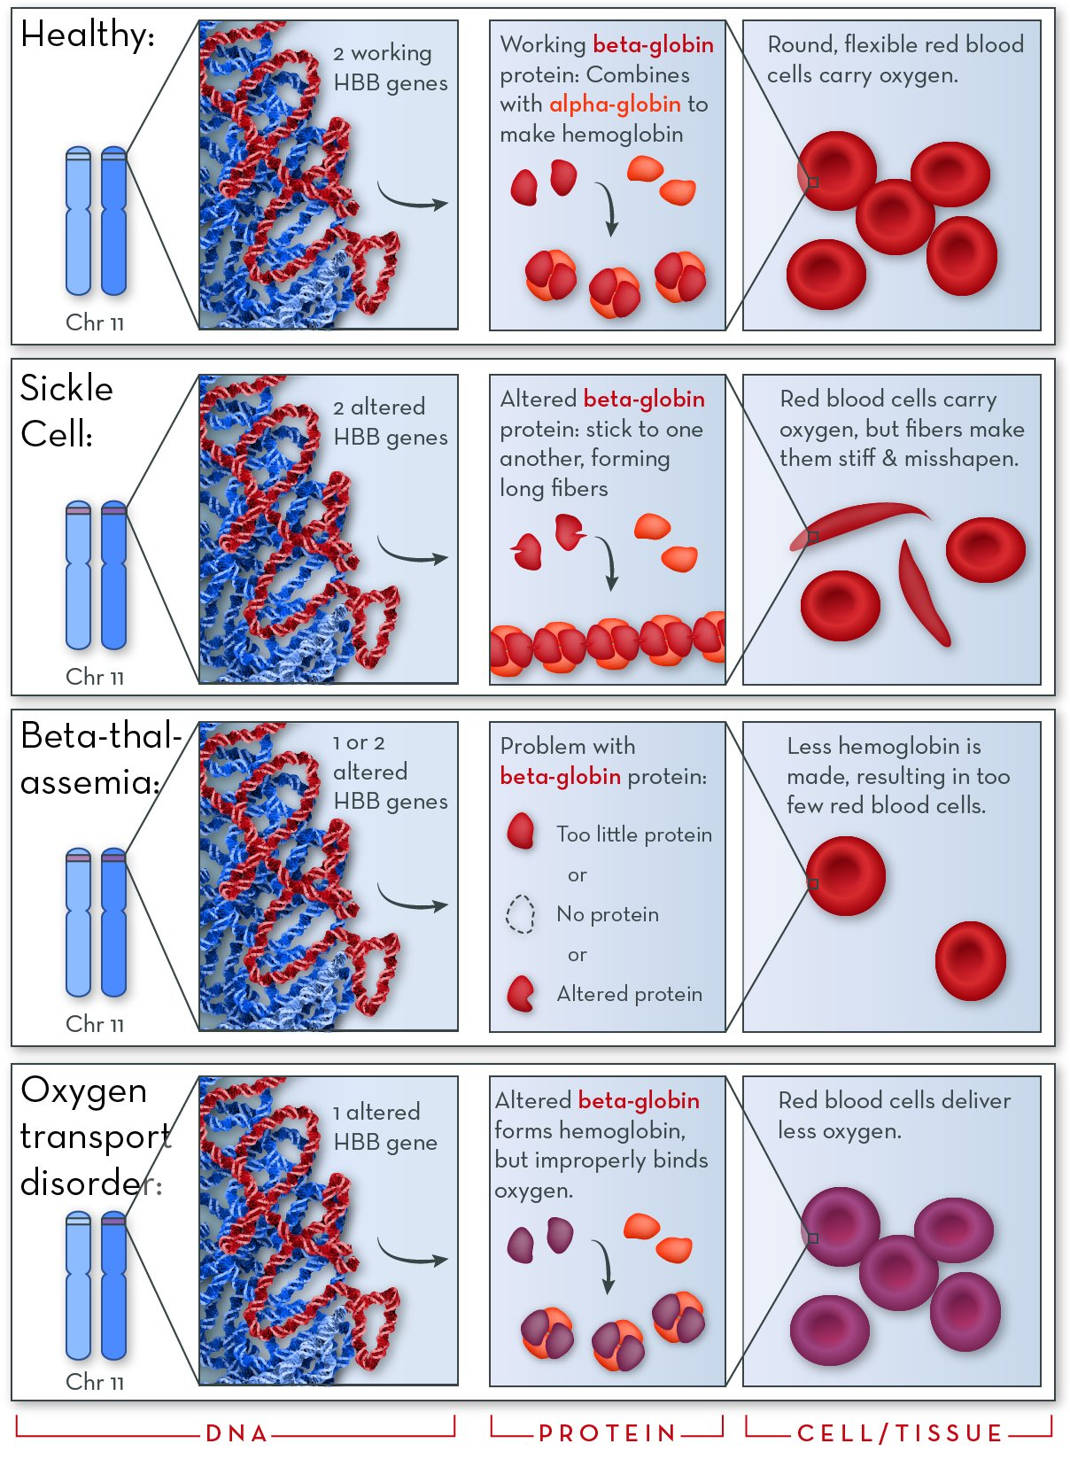
Hemoglobin disorders
Sickle cell anemia
Beta- thalassemia
Oxygen transport disorder

Slide 16
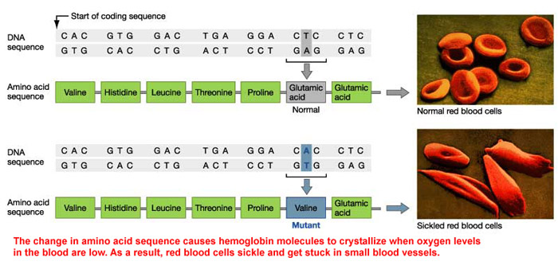
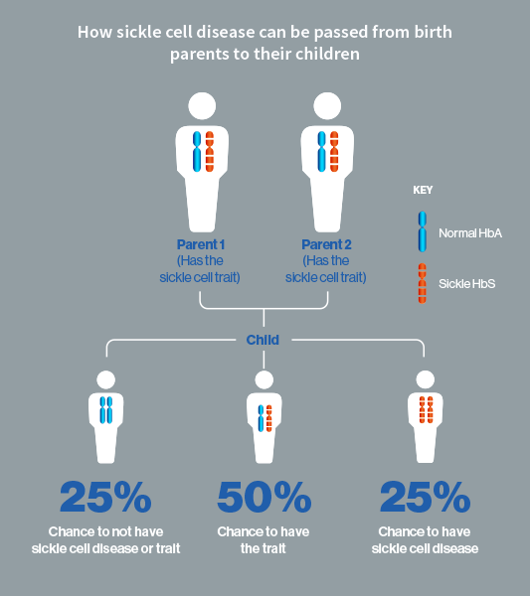
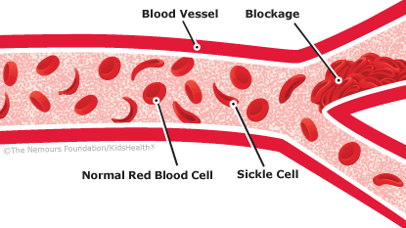

Slide 17
Step 1: Open the file HBB_mutant_Nucleotide.fasta
Step2: Let us Align both to see the difference (NCBI Align)
Step3: Translate the nucleotide to protein sequence (Expasy)
Step4: Align the protein sequence with MAFFT
Step5: Predict the protein structure with Phyre2 (pre-run)
Step6: View the pdb file and spot the difference in structure (Ezmol)

Slide 18
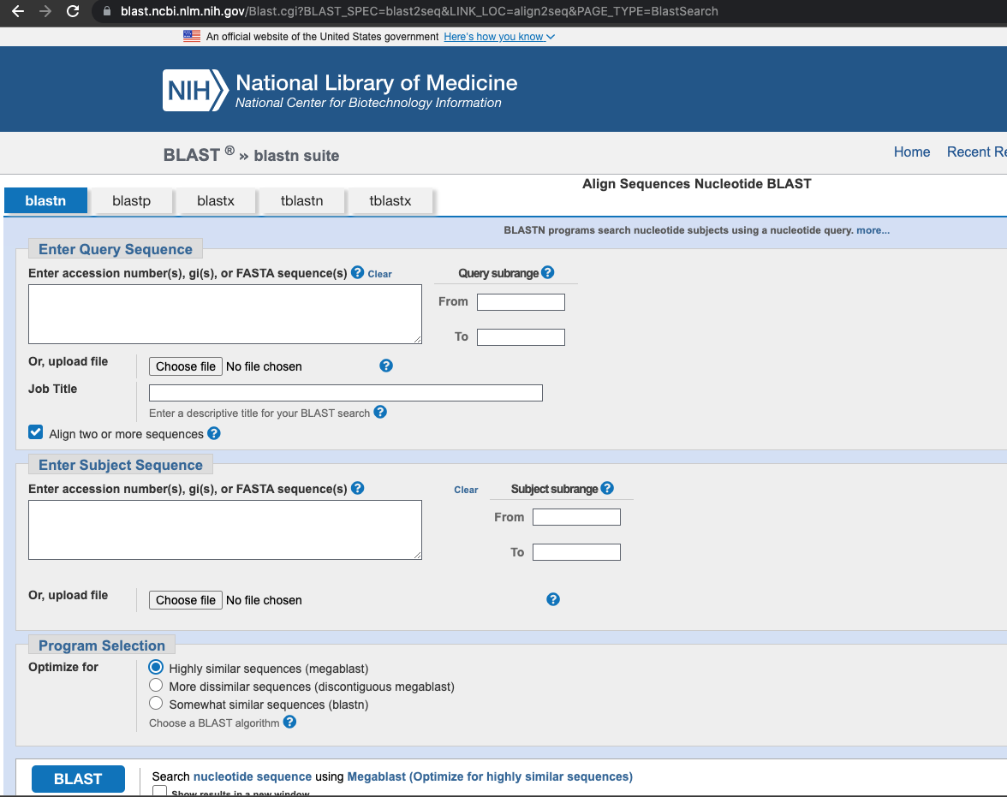
Step2

Slide 19
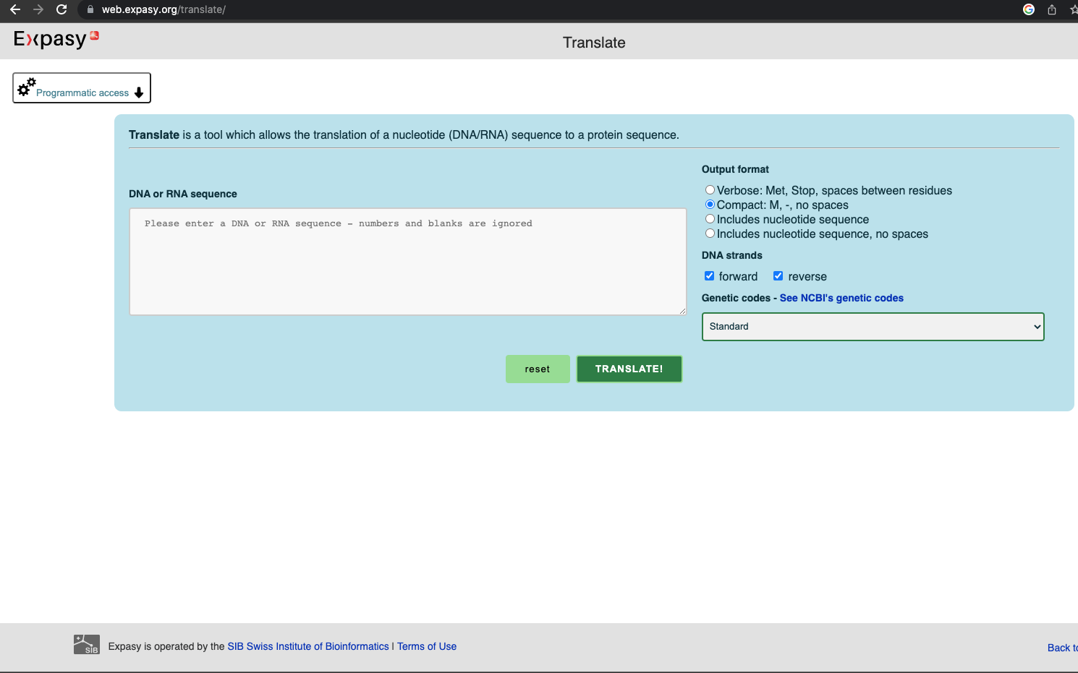
Step3

Slide 20
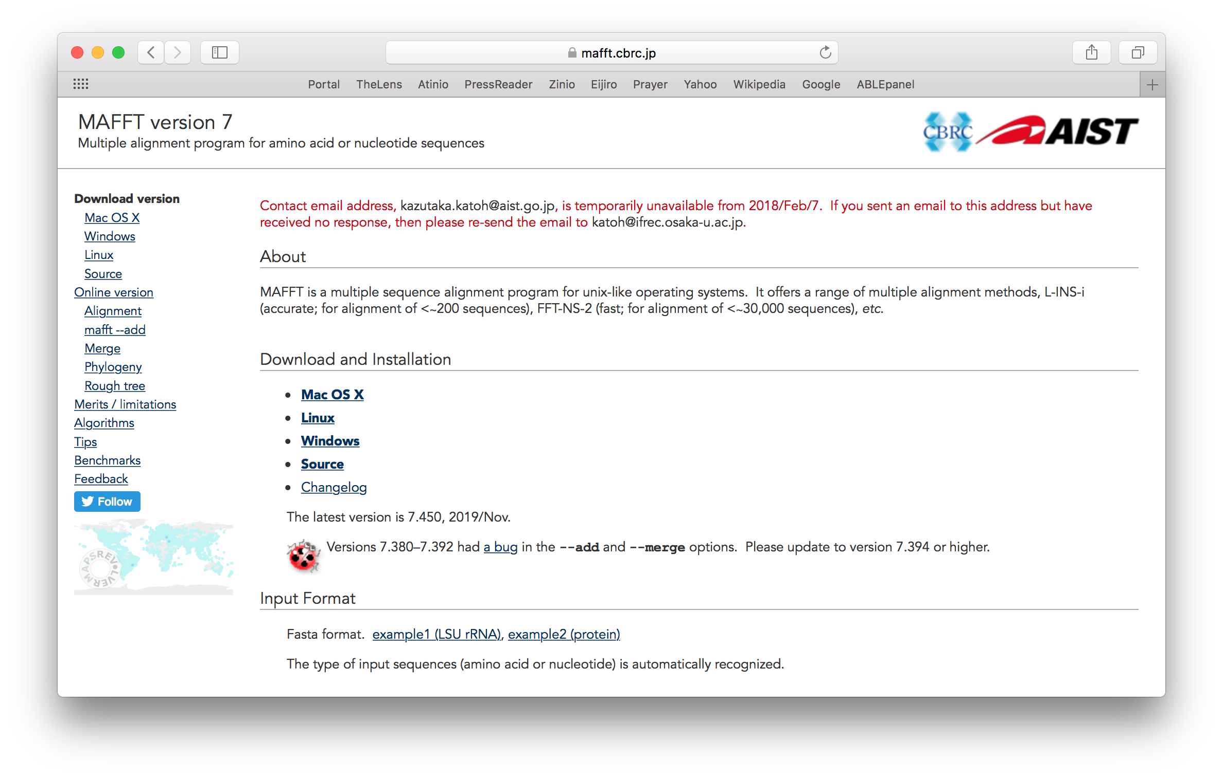
MAFFT
Step4

Slide 21
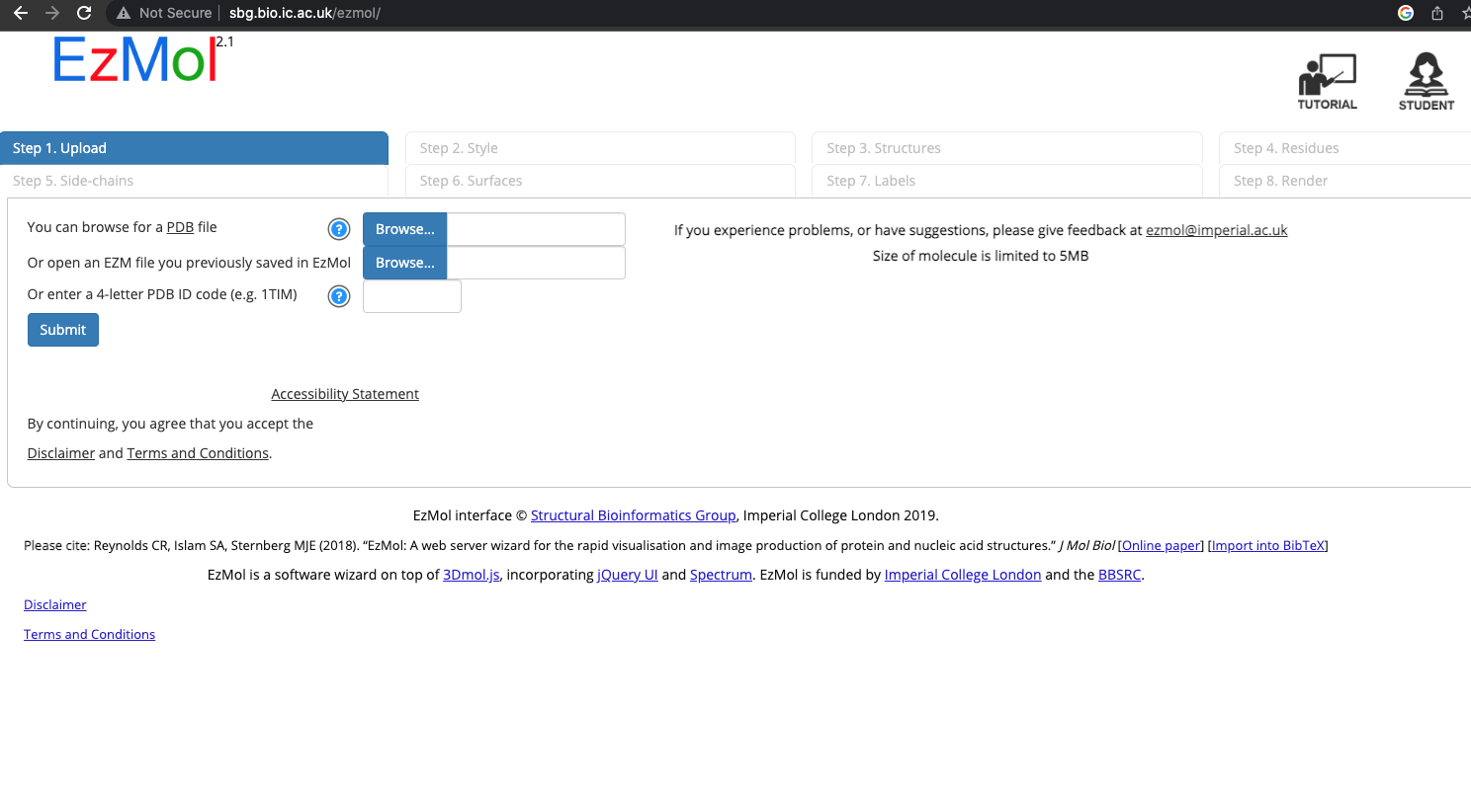
Step 6

Slide 22
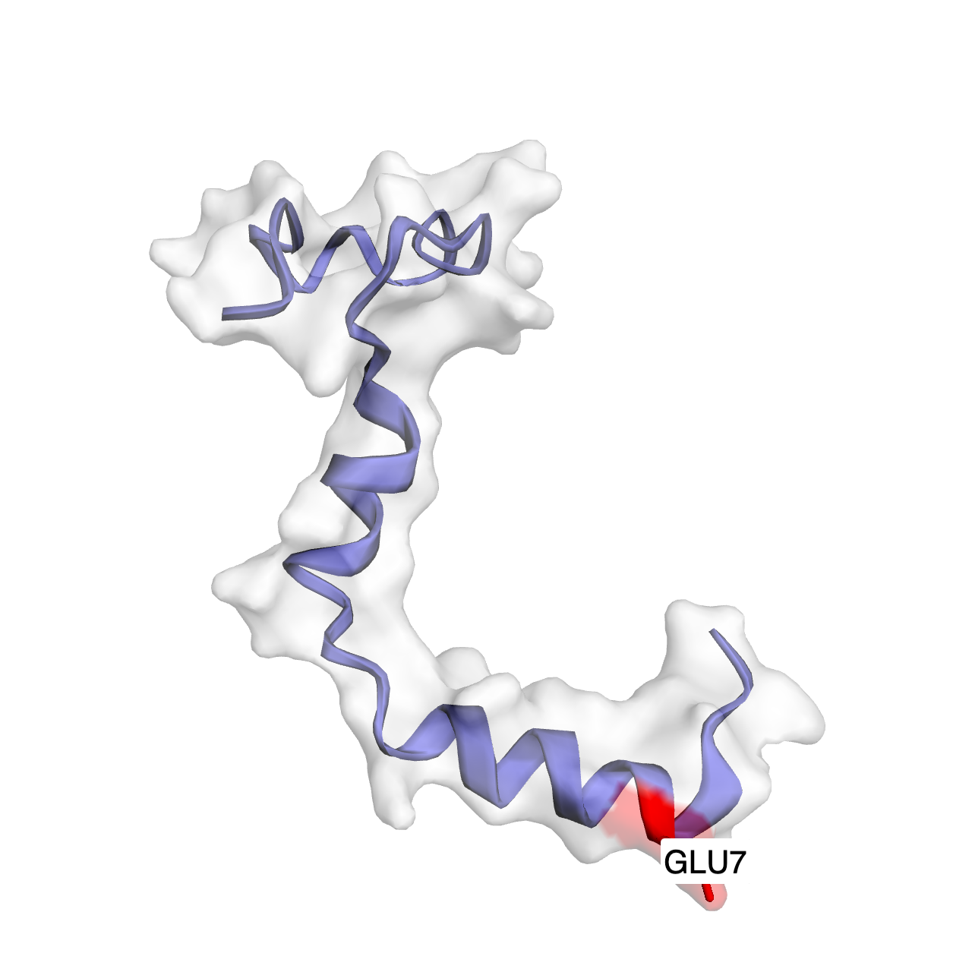
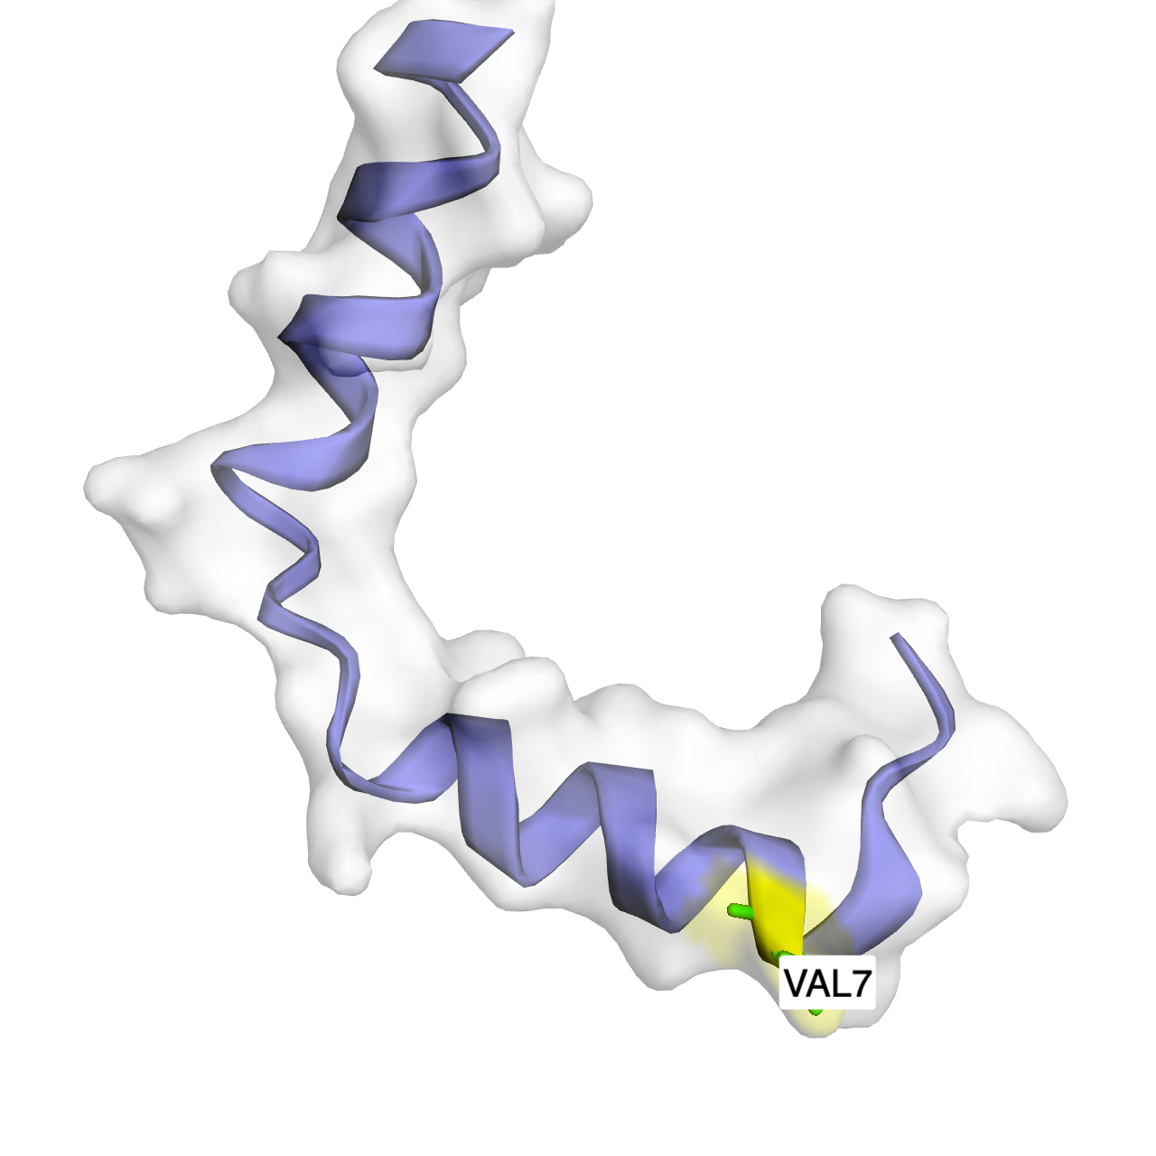

Slide 23
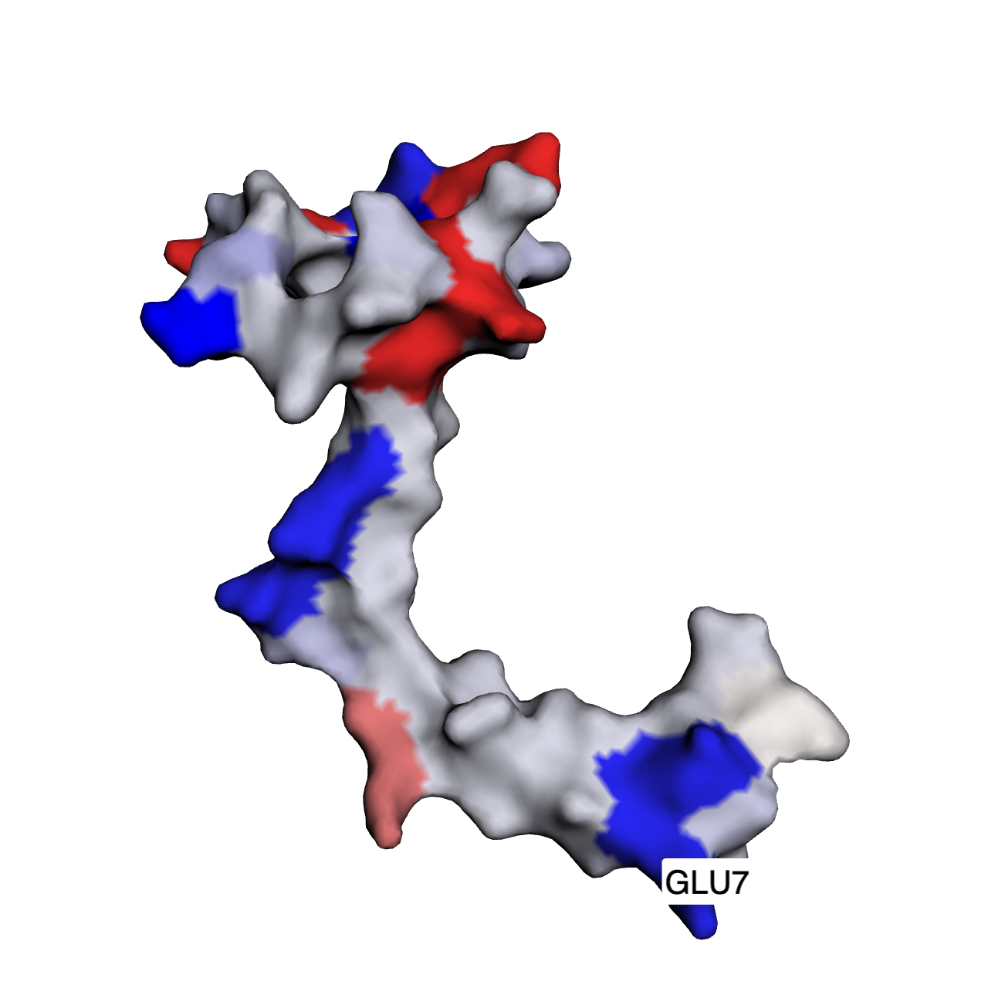
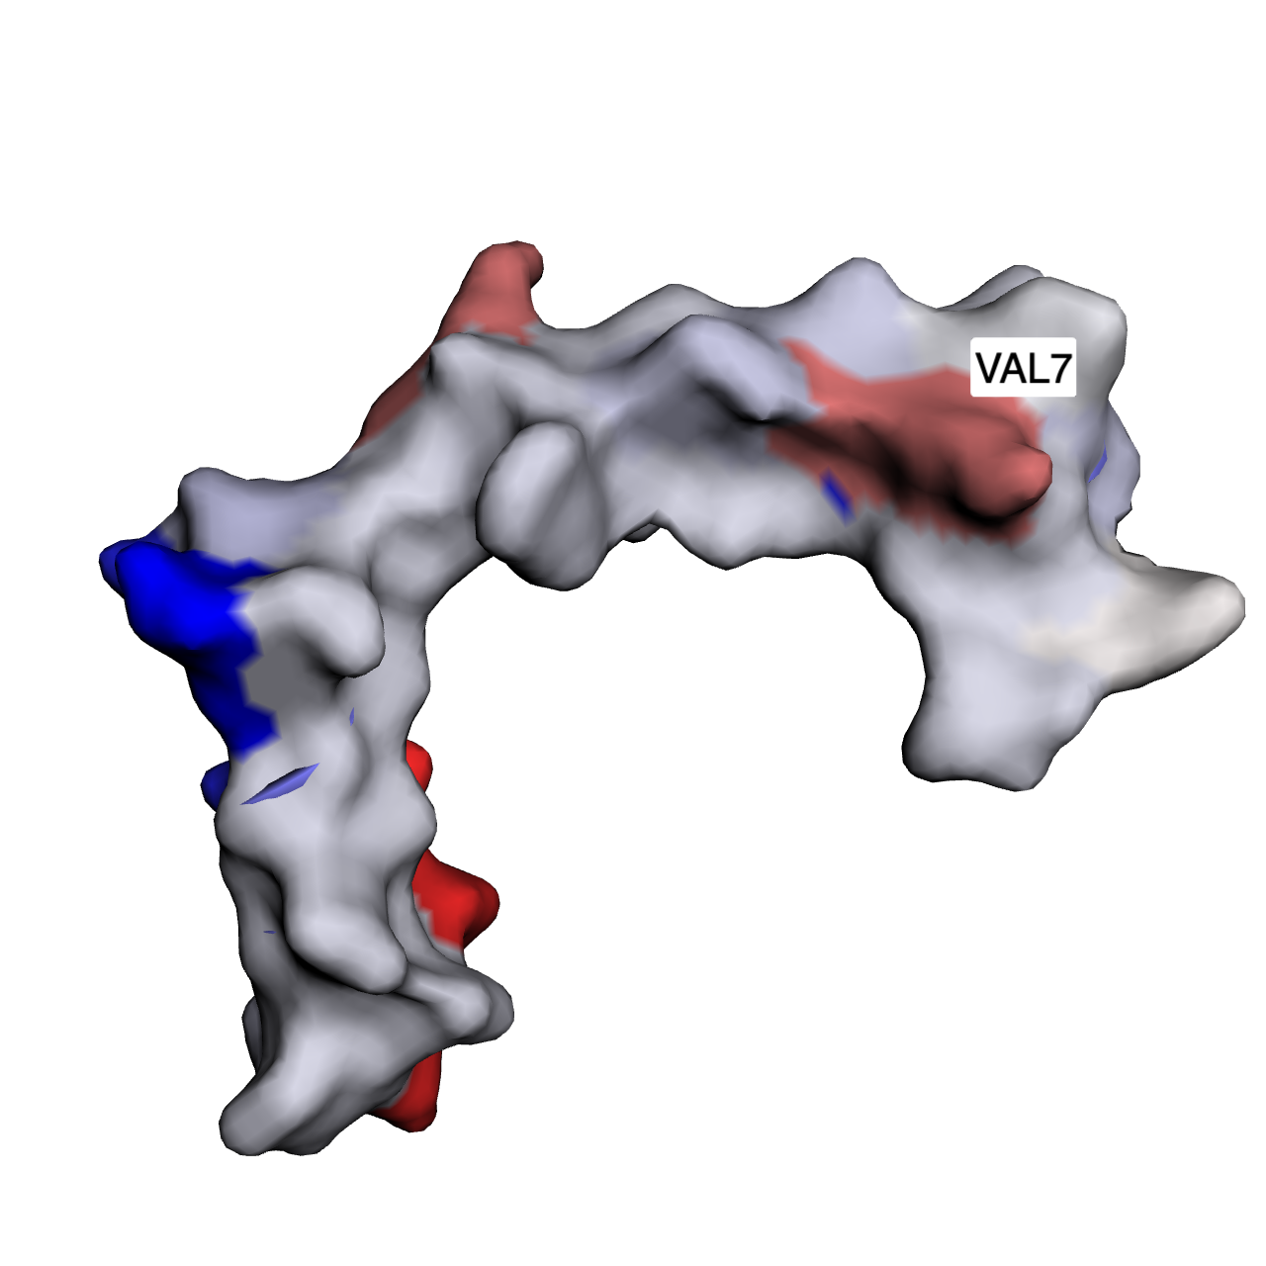

Slide 24
Phylogenetic Tree Construction
Collect DNA/protein Sequences
Make an Alignment
Calculate Genetic Distance (depends on method)
Draw a Tree

Slide 25
Phylogenetic Tree Construction
Actually, you have tons of options for it (if you are familiar with UNIX computing) :
ClustalW
MAFFT
PHYLIP
RAxML
TreeView
MEGA

Slide 26

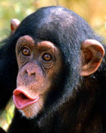
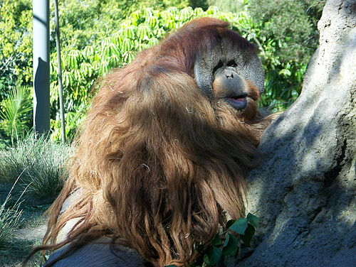
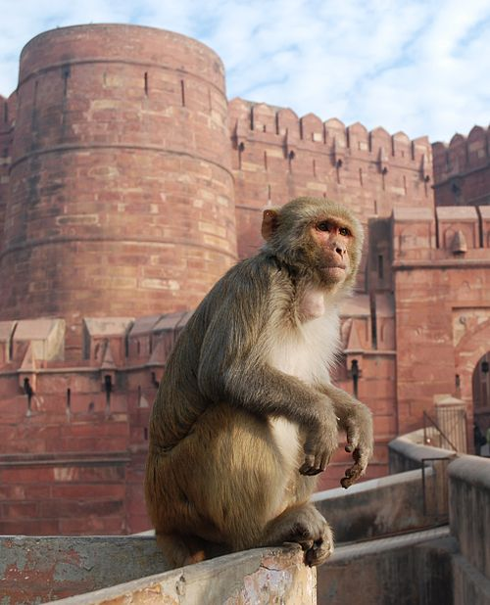
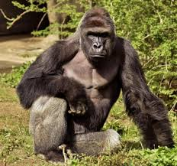
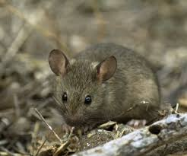
Let’s Reconstruct a Species-phylogeny of …
Human (Homo sapiens)
Chimpanzee (Pan troglodytes)
Orangutan (Pongo abelii)
(An outgroup)
Rhesus macaque
(Macaca mulatta)
Gorilla (Gorilla gorilla)
Mouse (Mus musculus)

Slide 27
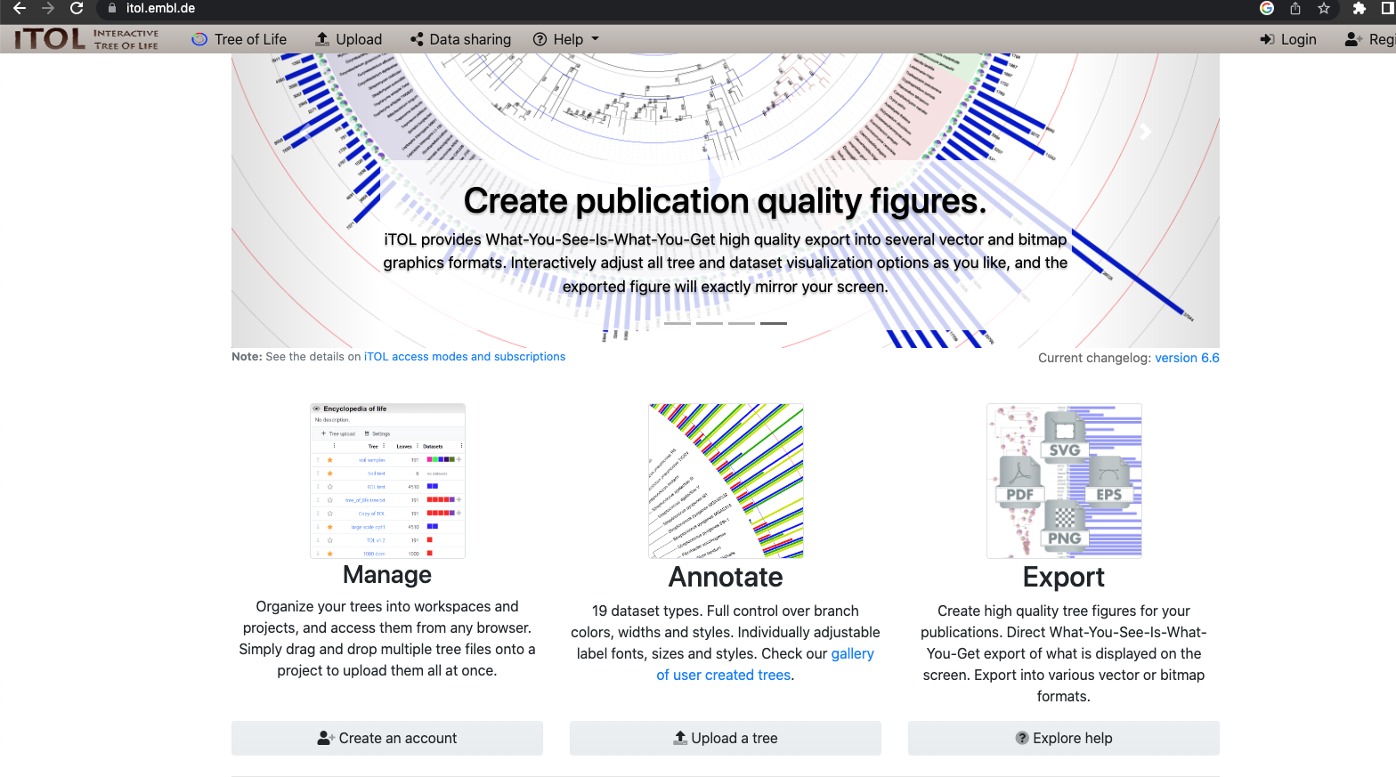
Step 1: Use 16s_rRNA.fasta
Step2: Align the DNA sequence with MAFFT
Step3: Use iTOL to draw phylogenetic tree

Slide 28
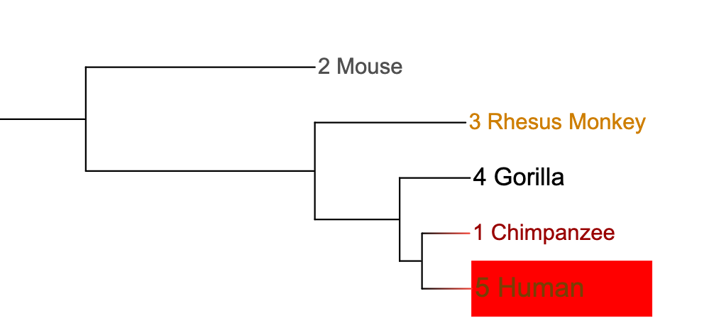

Slide 29
Your turn -> Use Hemoglobin A sequences to construct phylogeny

Slide 30
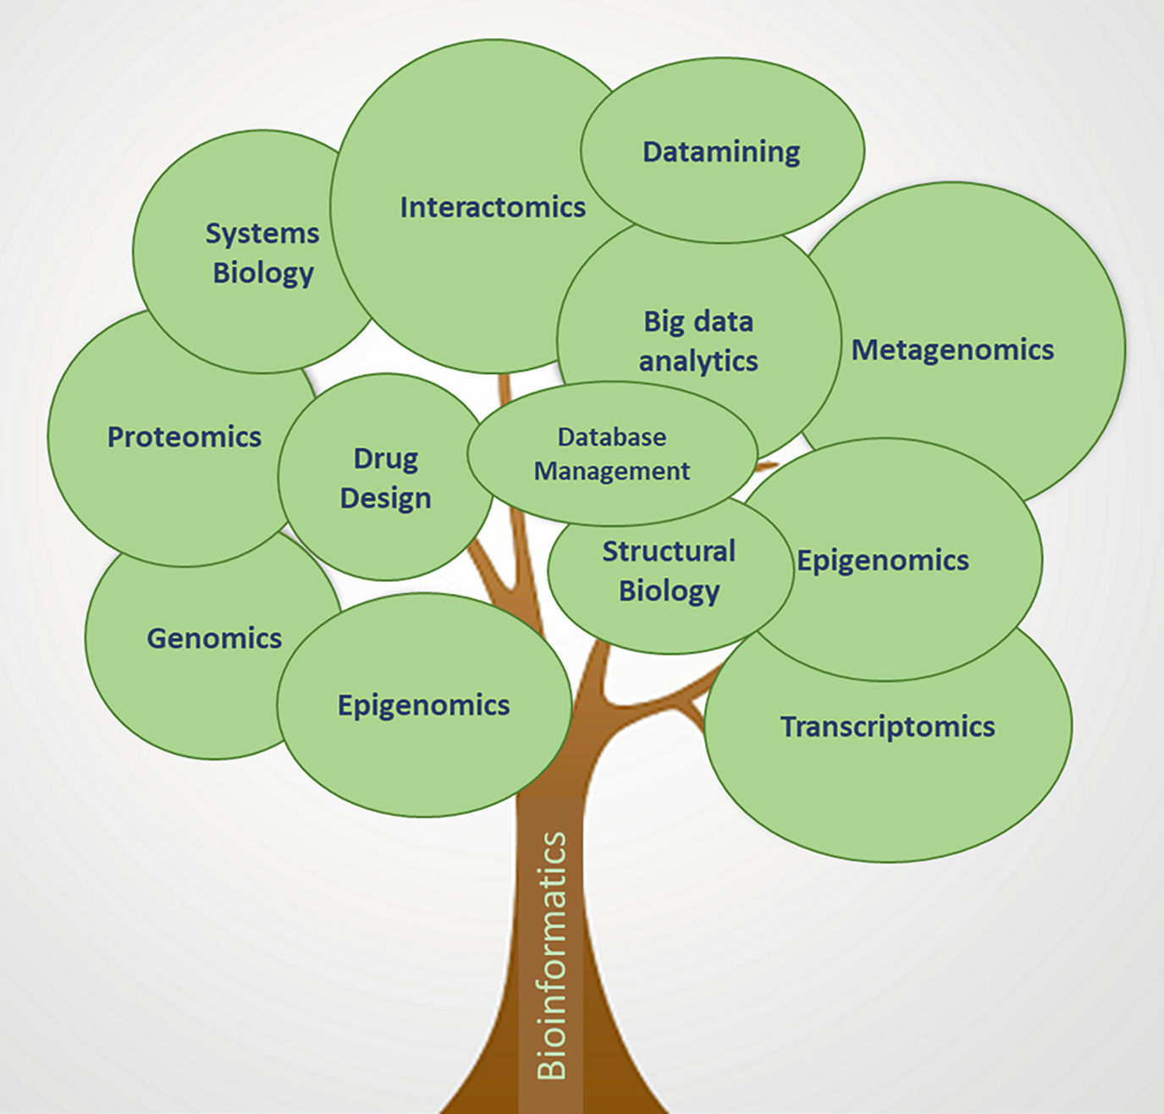
Summary
https://link.springer.com/chapter/10.1007/978-981-16-2339-4_30

